Slide 1
Convolutional Neural Network
Hung-yi Lee
Can the network be simplified by considering the properties of images?

Slide 2
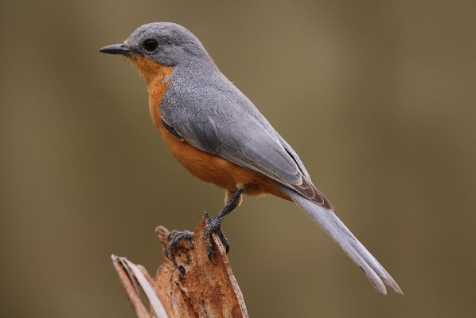

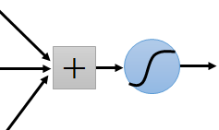
Why CNN for Image
Some patterns are much smaller than the whole image
A neuron does not have to see the whole image to discover the pattern.
Connecting to small region with less parameters
“beak” detector

Slide 3
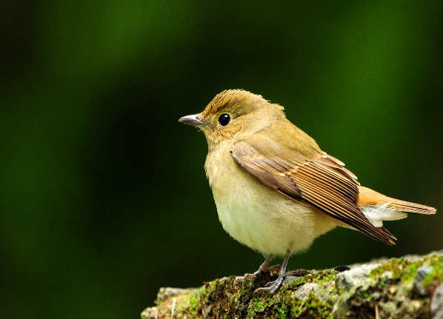
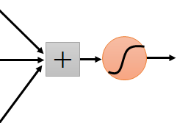
Why CNN for Image
The same patterns appear in different regions.
“upper-left beak” detector
Do almost the same thing
They can use the same set of parameters.
“middle beak” detector

Slide 4
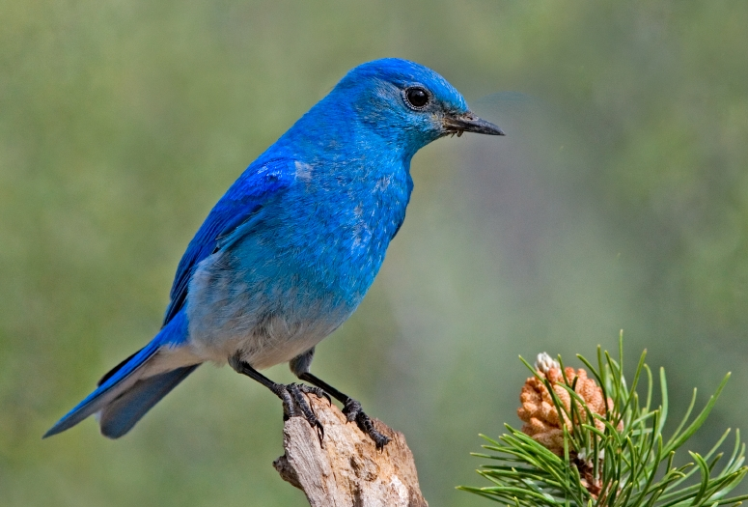

Why CNN for Image
Subsampling the pixels will not change the object
bird
bird
subsampling
We can subsample the pixels to make image smaller
Less parameters for the network to process the image

Slide 5
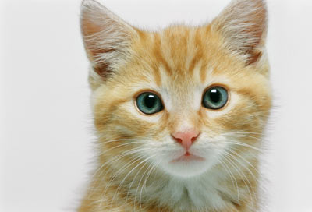
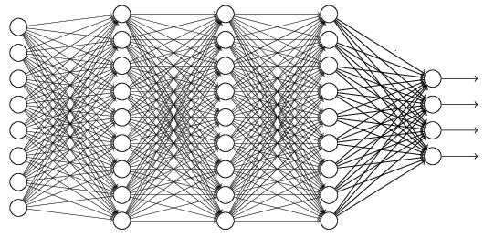
The whole CNN
cat dog ……
Convolution
Max Pooling
Can repeat many times
Fully Connected Feedforward network
Convolution
Max Pooling
Flatten

Slide 6
The whole CNN
Property 1
Some patterns are much smaller than the whole image
Convolution
Property 2
Max Pooling
The same patterns appear in different regions.
Can repeat many times
Property 3
Convolution
Subsampling the pixels will not change the object
Max Pooling
Flatten

Slide 7
The whole CNN
cat dog ……
Convolution
Max Pooling
Can repeat many times
Fully Connected Feedforward network
Convolution
Max Pooling
Flatten

Slide 8
CNN – Convolution
Those are the network parameters to be learned.
1 | -1 | -1
-1 | 1 | -1
-1 | -1 | 1
1 | 0 | 0 | 0 | 0 | 1
0 | 1 | 0 | 0 | 1 | 0
0 | 0 | 1 | 1 | 0 | 0
1 | 0 | 0 | 0 | 1 | 0
0 | 1 | 0 | 0 | 1 | 0
0 | 0 | 1 | 0 | 1 | 0
Filter 1
Matrix
-1 | 1 | -1
-1 | 1 | -1
-1 | 1 | -1
Filter 2
Matrix
……
6 x 6 image
Each filter detects a small pattern (3 x 3).
Property 1

Slide 9
CNN – Convolution
1 | -1 | -1
-1 | 1 | -1
-1 | -1 | 1
Filter 1
stride=1
1 | 0 | 0 | 0 | 0 | 1
0 | 1 | 0 | 0 | 1 | 0
0 | 0 | 1 | 1 | 0 | 0
1 | 0 | 0 | 0 | 1 | 0
0 | 1 | 0 | 0 | 1 | 0
0 | 0 | 1 | 0 | 1 | 0
3
-1
6 x 6 image

Slide 10
CNN – Convolution
1 | -1 | -1
-1 | 1 | -1
-1 | -1 | 1
Filter 1
If stride=2
1 | 0 | 0 | 0 | 0 | 1
0 | 1 | 0 | 0 | 1 | 0
0 | 0 | 1 | 1 | 0 | 0
1 | 0 | 0 | 0 | 1 | 0
0 | 1 | 0 | 0 | 1 | 0
0 | 0 | 1 | 0 | 1 | 0
3
-3
We set stride=1 below
6 x 6 image

Slide 11
CNN – Convolution
1 | -1 | -1
-1 | 1 | -1
-1 | -1 | 1
Filter 1
stride=1
1 | 0 | 0 | 0 | 0 | 1
0 | 1 | 0 | 0 | 1 | 0
0 | 0 | 1 | 1 | 0 | 0
1 | 0 | 0 | 0 | 1 | 0
0 | 1 | 0 | 0 | 1 | 0
0 | 0 | 1 | 0 | 1 | 0
3
-1
-3
-1
-3
1
0
-3
-3
-3
0
1
3
-2
-2
-1
6 x 6 image
Property 2

Slide 12
CNN – Convolution
-1 | 1 | -1
-1 | 1 | -1
-1 | 1 | -1
Filter 2
stride=1
Do the same process for every filter
1 | 0 | 0 | 0 | 0 | 1
0 | 1 | 0 | 0 | 1 | 0
0 | 0 | 1 | 1 | 0 | 0
1 | 0 | 0 | 0 | 1 | 0
0 | 1 | 0 | 0 | 1 | 0
0 | 0 | 1 | 0 | 1 | 0
3
-1
-3
-1
-1
-1
-1
-1
-3
1
0
-3
-1
-1
-2
1
Feature
Map
-3
-3
0
1
-1
-1
-2
1
3
-2
-2
-1
6 x 6 image
-1
0
-4
3
4 x 4 image

Slide 13
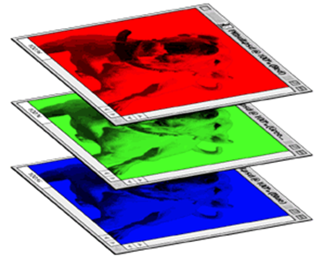
CNN – Colorful image
1 | -1 | -1
-1 | 1 | -1
-1 | -1 | 1
-1 | 1 | -1
-1 | 1 | -1
-1 | 1 | -1
1 | -1 | -1
-1 | 1 | -1
-1 | -1 | 1
-1 | 1 | -1
-1 | 1 | -1
-1 | 1 | -1
1 | -1 | -1
-1 | 1 | -1
-1 | -1 | 1
-1 | 1 | -1
-1 | 1 | -1
-1 | 1 | -1
Filter 1
Filter 2
Colorful image
1 | 0 | 0 | 0 | 0 | 1
0 | 1 | 0 | 0 | 1 | 0
0 | 0 | 1 | 1 | 0 | 0
1 | 0 | 0 | 0 | 1 | 0
0 | 1 | 0 | 0 | 1 | 0
0 | 0 | 1 | 0 | 1 | 0
1 | 0 | 0 | 0 | 0 | 1
0 | 1 | 0 | 0 | 1 | 0
0 | 0 | 1 | 1 | 0 | 0
1 | 0 | 0 | 0 | 1 | 0
0 | 1 | 0 | 0 | 1 | 0
0 | 0 | 1 | 0 | 1 | 0
1 | 0 | 0 | 0 | 0 | 1
0 | 1 | 0 | 0 | 1 | 0
0 | 0 | 1 | 1 | 0 | 0
1 | 0 | 0 | 0 | 1 | 0
0 | 1 | 0 | 0 | 1 | 0
0 | 0 | 1 | 0 | 1 | 0

Slide 14
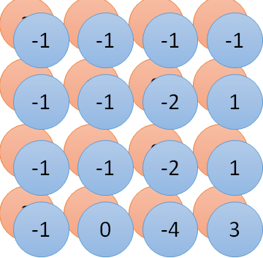
Convolution v.s. Fully Connected
1 | 0 | 0 | 0 | 0 | 1
0 | 1 | 0 | 0 | 1 | 0
0 | 0 | 1 | 1 | 0 | 0
1 | 0 | 0 | 0 | 1 | 0
0 | 1 | 0 | 0 | 1 | 0
0 | 0 | 1 | 0 | 1 | 0
1 | -1 | -1
-1 | 1 | -1
-1 | -1 | 1
-1 | 1 | -1
-1 | 1 | -1
-1 | 1 | -1
convolution
image
1 | 0 | 0 | 0 | 0 | 1
0 | 1 | 0 | 0 | 1 | 0
0 | 0 | 1 | 1 | 0 | 0
1 | 0 | 0 | 0 | 1 | 0
0 | 1 | 0 | 0 | 1 | 0
0 | 0 | 1 | 0 | 1 | 0
Fully-connected
……
……

Slide 15
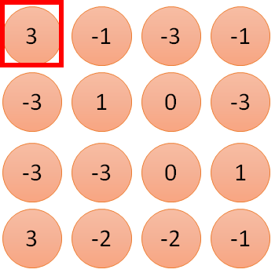
1 | -1 | -1
-1 | 1 | -1
-1 | -1 | 1
1:
1
Filter 1
2:
0
3:
0
3
4:
0
1 | 0 | 0 | 0 | 0 | 1
0 | 1 | 0 | 0 | 1 | 0
0 | 0 | 1 | 1 | 0 | 0
1 | 0 | 0 | 0 | 1 | 0
0 | 1 | 0 | 0 | 1 | 0
0 | 0 | 1 | 0 | 1 | 0
…
7:
0
8:
1
9:
0
10:
0
…
13:
0
6 x 6 image
14:
0
Less parameters!
15:
Only connect to 9 input, not fully connected
1
16:
1
…

Slide 16
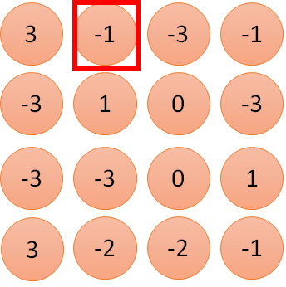
1 | -1 | -1
-1 | 1 | -1
-1 | -1 | 1
1:
1
Filter 1
2:
0
3:
0
3
4:
0
1 | 0 | 0 | 0 | 0 | 1
0 | 1 | 0 | 0 | 1 | 0
0 | 0 | 1 | 1 | 0 | 0
1 | 0 | 0 | 0 | 1 | 0
0 | 1 | 0 | 0 | 1 | 0
0 | 0 | 1 | 0 | 1 | 0
…
7:
0
8:
1
-1
9:
0
10:
0
…
13:
0
6 x 6 image
14:
0
Less parameters!
15:
1
16:
1
Shared weights
Even less parameters!
…

Slide 17
The whole CNN
cat dog ……
Convolution
Max Pooling
Can repeat many times
Fully Connected Feedforward network
Convolution
Max Pooling
Flatten

Slide 18
CNN – Max Pooling
1 | -1 | -1
-1 | 1 | -1
-1 | -1 | 1
-1 | 1 | -1
-1 | 1 | -1
-1 | 1 | -1
Filter 1
Filter 2
3
-1
-3
-1
-1
-1
-1
-1
-3
1
0
-3
-1
-1
-2
1
-3
-3
0
1
-1
-1
-2
1
3
-2
-2
-1
-1
0
-4
3

Slide 19
CNN – Max Pooling
New image
but smaller
1 | 0 | 0 | 0 | 0 | 1
0 | 1 | 0 | 0 | 1 | 0
0 | 0 | 1 | 1 | 0 | 0
1 | 0 | 0 | 0 | 1 | 0
0 | 1 | 0 | 0 | 1 | 0
0 | 0 | 1 | 0 | 1 | 0
Conv
3
0
-1
1
Max
Pooling
3
1
0
3
2 x 2 image
6 x 6 image
Each filter
is a channel

Slide 20
The whole CNN
3
0
-1
1
Convolution
3
1
0
3
Max Pooling
Can repeat many times
A new image
Convolution
Smaller than the original image
The number of the channel is the number of filters
Max Pooling

Slide 21
The whole CNN
cat dog ……
Convolution
Max Pooling
A new image
Fully Connected Feedforward network
Convolution
Max Pooling
A new image
Flatten

Slide 22
Flatten
3
0
1
3
0
-1
1
3
3
1
-1
0
3
Flatten
1
Fully Connected Feedforward network
0
3

Slide 23
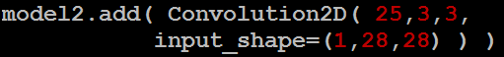
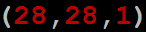

CNN in Keras
Only modified the network structure and input format (vector -> 3-D tensor)
input
Convolution
1 | -1 | -1
-1 | 1 | -1
-1 | -1 | 1
-1 | 1 | -1
-1 | 1 | -1
-1 | 1 | -1
There are 25 3x3 filters.
……
Max Pooling
Input_shape = ( 28 , 28 , 1)
28 x 28 pixels
1: black/white, 3: RGB
Convolution
3
-1
3
Max Pooling
-3
1

Slide 24


CNN in Keras
Only modified the network structure and input format (vector -> 3-D tensor)
input
1 x 28 x 28
Convolution
How many parameters for each filter?
9
25 x 26 x 26
Max Pooling
25 x 13 x 13
Convolution
How many parameters for each filter?
225
50 x 11 x 11
Max Pooling
50 x 5 x 5

Slide 25
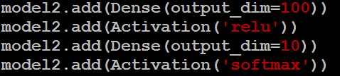

CNN in Keras
Only modified the network structure and input format (vector -> 3-D tensor)
input
1 x 28 x 28
output
Convolution
25 x 26 x 26
Fully Connected Feedforward network
Max Pooling
25 x 13 x 13
Convolution
50 x 11 x 11
Max Pooling
1250
50 x 5 x 5
Flatten

Slide 26
Live Demo

Slide 27
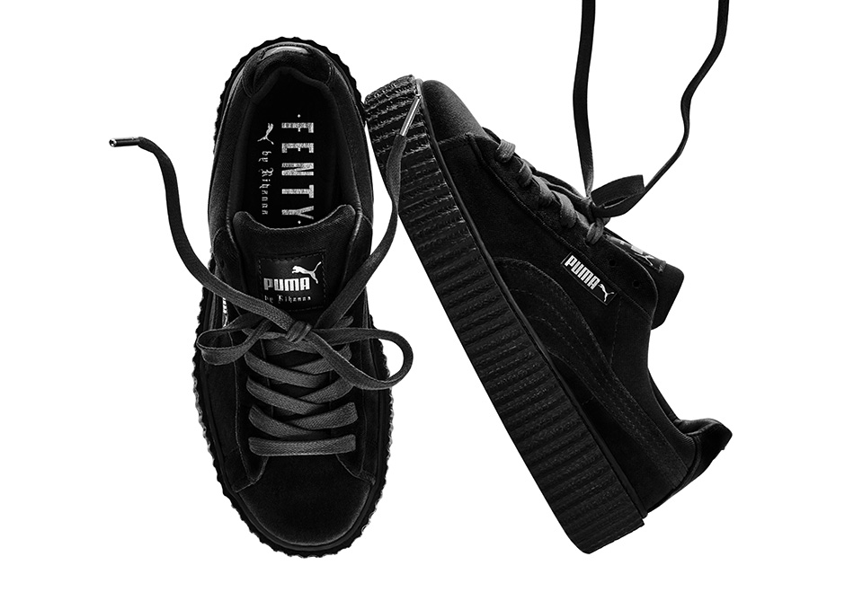

What does machine learn?
球鞋
美洲獅
http://newsneakernews.wpengine.netdna-cdn.com/wp-content/uploads/2016/11/rihanna-puma-creeper-velvet-release-date-02.jpg

Slide 28
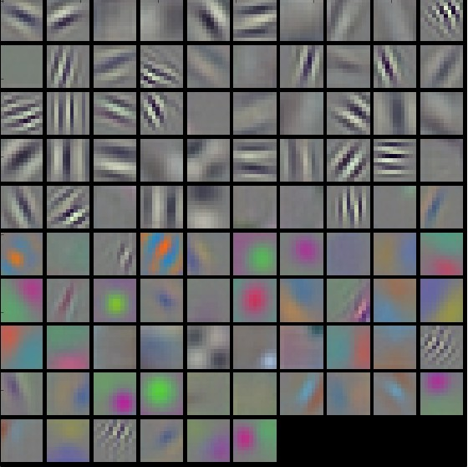
First Convolution Layer
Typical-looking filters on the trained first layer
11 x 11
(AlexNet)
http://cs231n.github.io/understanding-cnn/
Notes:
The color/grayscale features are clustered because the AlexNet contains two separate streams of processing, and an apparent consequence of this architecture is that one stream develops high-frequency grayscale features and the other low-frequency color features
Typical-looking filters on the first CONV layer (left), and the 2nd CONV layer (right) of a trained AlexNet. Notice that the first-layer weights are very nice and smooth, indicating nicely converged network.

Slide 29
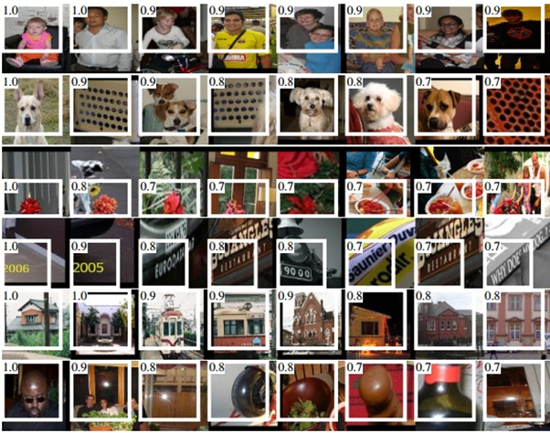
How about higher layers?
Which images make a specific neuron activate
Ross Girshick, Jeff Donahue, Trevor Darrell, Jitendra Malik, “Rich feature hierarchies for accurate object detection and semantic segmentation”, CVPR, 2014
Notes:
From “rcnn”
Maximally activating images for some POOL5 (5th pool layer) neurons of an AlexNet. The activation values and the receptive field of the particular neuron are shown in white. (In particular, note that the POOL5 neurons are a function of a relatively large portion of the input image!) It can be seen that some neurons are responsive to upper bodies, text, or specular highlights.

Slide 30

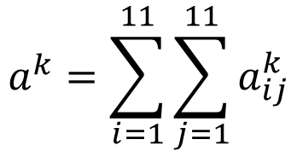
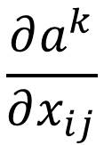
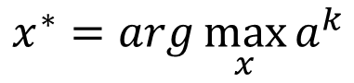
What does CNN learn?
$$\frac{∂a^{k}}{∂x_{ij}}$$
The output of the k-th filter is a 11 x 11 matrix.
x
input
Degree of the activation of the k-th filter:
$$a^{k}=\sum_{i=1}^{11}{\sum_{j=1}^{11}{a_{ij}^{k}}}$$
25 3x3 filters
Convolution
$$x^{∗}=arg\max_{x}{a^{k}}$$
(gradient ascent)
11
Max Pooling
3
-1
……
-1
50 3x3 filters
$$a_{ij}^{k}$$
Convolution
-3
1
……
-3
11
50 x 11 x 11
……
……
……
Max Pooling
3
-2
……
-1

Slide 31
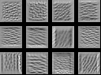
What does CNN learn?
$$\frac{∂a^{k}}{∂x_{ij}}$$
The output of the k-th filter is a 11 x 11 matrix.
input
Degree of the activation of the k-th filter:
$$a^{k}=\sum_{i=1}^{11}{\sum_{j=1}^{11}{a_{ij}^{k}}}$$
25 3x3 filters
Convolution
$$x^{∗}=arg\max_{x}{a^{k}}$$
(gradient ascent)
Max Pooling
50 3x3 filters
Convolution
50 x 11 x 11
Max Pooling
For each filter

Slide 32
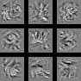
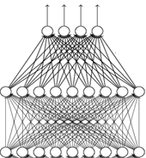

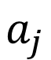
What does CNN learn?
input
Find an image maximizing the output of neuron:
Convolution
$$x^{∗}=arg\max_{x}{a^{j}}$$
Max Pooling
Convolution
Max Pooling
flatten
Each figure corresponds to a neuron
$$a_{j}$$

Slide 33
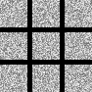
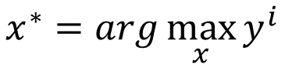
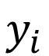
What does CNN learn?
input
$$x^{∗}=arg\max_{x}{y^{i}}$$
Can we see digits?
Convolution
Max Pooling
0
1
2
Convolution
Max Pooling
3
4
5
flatten
6
7
8
Deep Neural Networks are Easily Fooled
https://www.youtube.com/watch?v=M2IebCN9Ht4
$$y_{i}$$

Slide 34
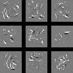
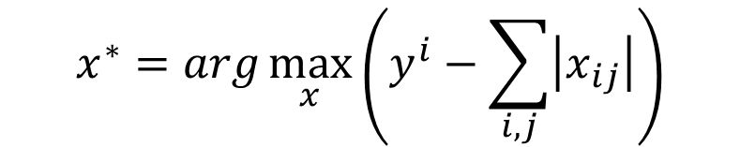
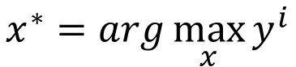
What does CNN learn?
Over all pixel values
$$x^{∗}=arg\max_{x}\left(y^{i}−\sum_{i,j}{\left|x_{ij}\right|}\right)$$
$$x^{∗}=arg\max_{x}{y^{i}}$$
0
1
2
0
1
2
3
4
5
3
4
5
6
7
8
6
7
8

Slide 35
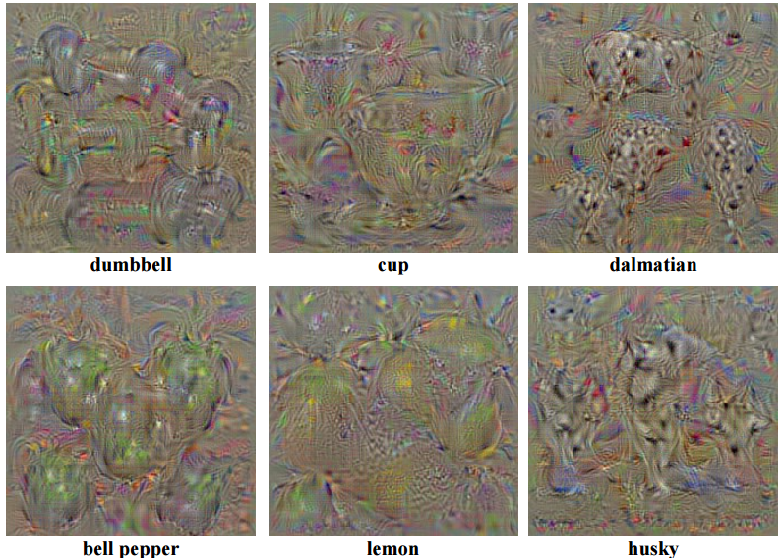
Karen Simonyan, Andrea Vedaldi, Andrew Zisserman, “Deep Inside Convolutional Networks: Visualising Image Classification Models and Saliency Maps”, ICLR, 2014

Slide 36
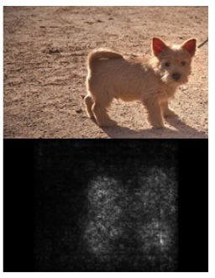
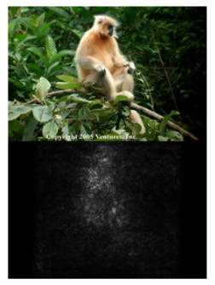
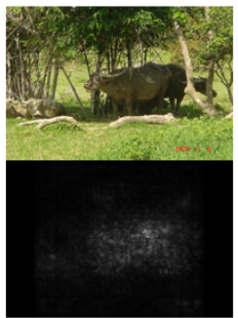
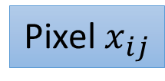
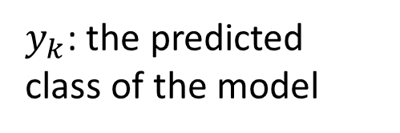
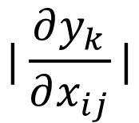
$$|\frac{∂y_{k}}{∂x_{ij}}|$$
$y_{k}$: the predicted class of the model
Pixel $x_{ij}$
Karen Simonyan, Andrea Vedaldi, Andrew Zisserman, “Deep Inside Convolutional Networks: Visualising Image Classification Models and Saliency Maps”, ICLR, 2014

Slide 37
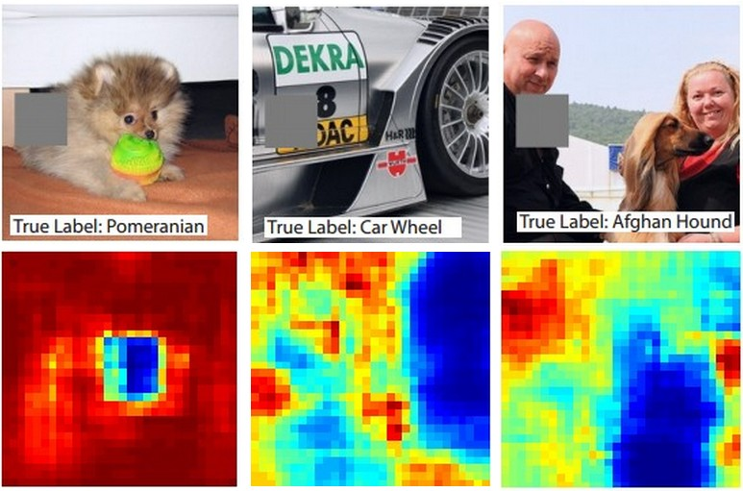
Reference: Zeiler, M. D., & Fergus, R. (2014). Visualizing and understanding convolutional networks. In Computer Vision–ECCV 2014 (pp. 818-833)

Slide 38
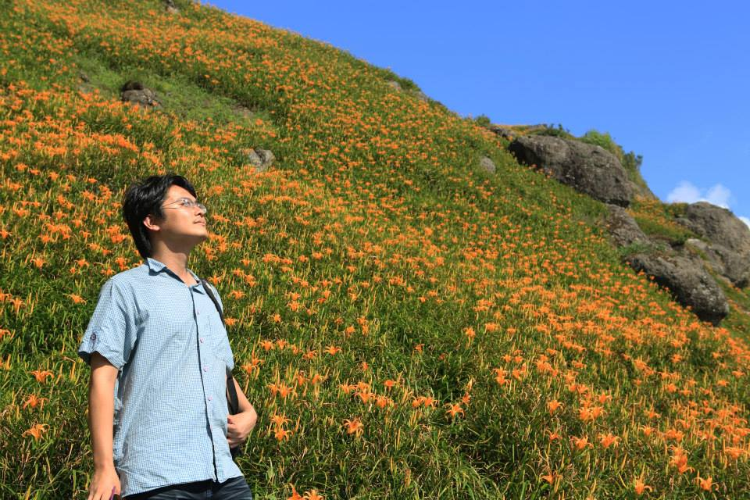

Deep Dream
CNN
Modify image
Given a photo, machine adds what it sees ……
$$\left[\begin{aligned}3.9 \\ −1.5 \\ 2.3 \\ ⋮\end{aligned}\right]$$
CNN exaggerates what it sees
http://deepdreamgenerator.com/
Notes:
http://speech.ee.ntu.edu.tw/dokuwiki/lib/exe/fetch.php?media=speech:meeting:paper_report:paper_report_2015-08-12.pdf

Slide 39

Deep Dream
Given a photo, machine adds what it sees ……
http://deepdreamgenerator.com/

Slide 40
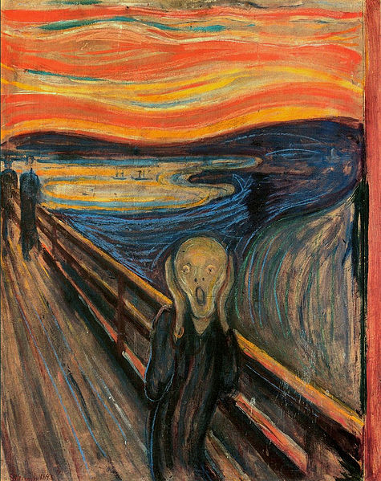
Deep Style
Given a photo, make its style like famous paintings
https://dreamscopeapp.com/

Slide 41
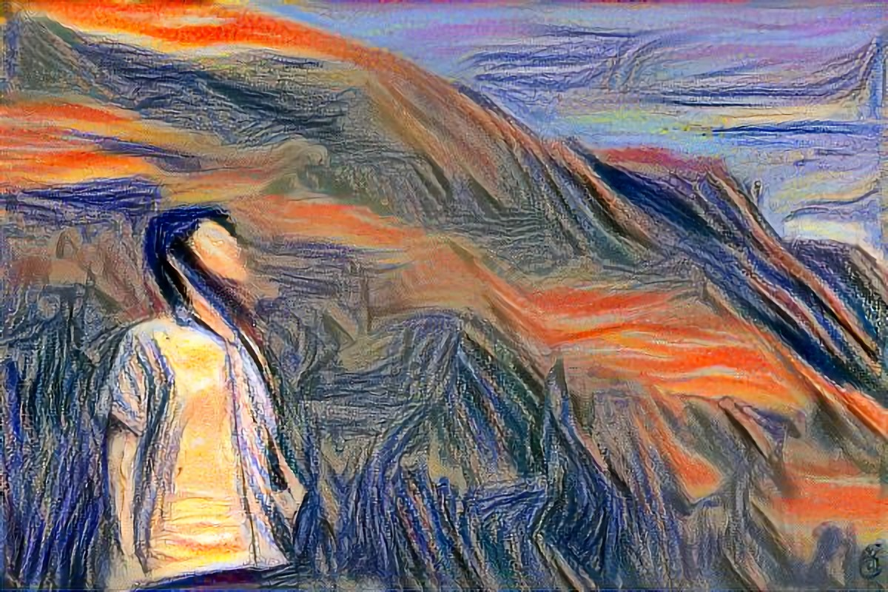
Deep Style
Given a photo, make its style like famous paintings
https://dreamscopeapp.com/

Slide 42

Deep Style
CNN
CNN
A Neural Algorithm of Artistic Style
https://arxiv.org/abs/1508.06576
content
style
CNN
?

Slide 43
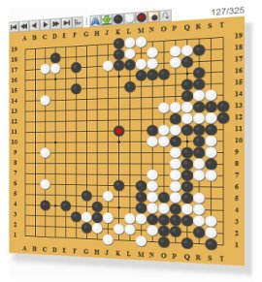
More Application: Playing Go
Network
Next move
(19 x 19 positions)
19 x 19 matrix (image)
19 x 19 vector
19 x 19 vector
Fully-connected feedforward network can be used
Black: 1
white: -1
none: 0
But CNN performs much better.

Slide 44
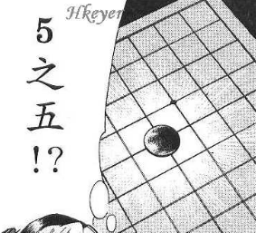


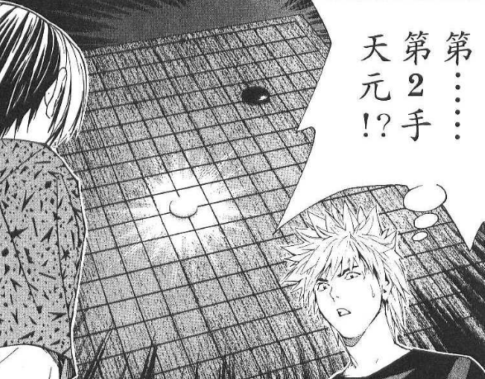
More Application: Playing Go
record of previous plays
Training:
黑: 5之五
白: 天元
黑: 五之5 …
Target:
“天元” = 1
else = 0
CNN
Target:
“五之 5” = 1
else = 0
CNN

Slide 45
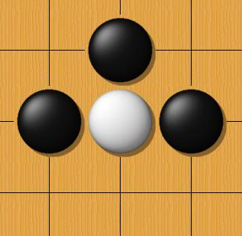
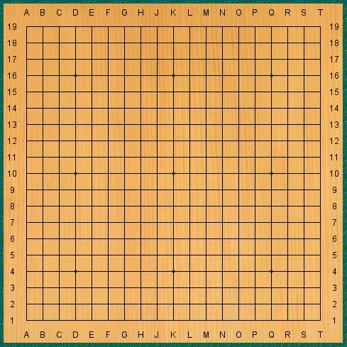
Why CNN for playing Go?
Some patterns are much smaller than the whole image
The same patterns appear in different regions.
Alpha Go uses 5 x 5 for first layer

Slide 46
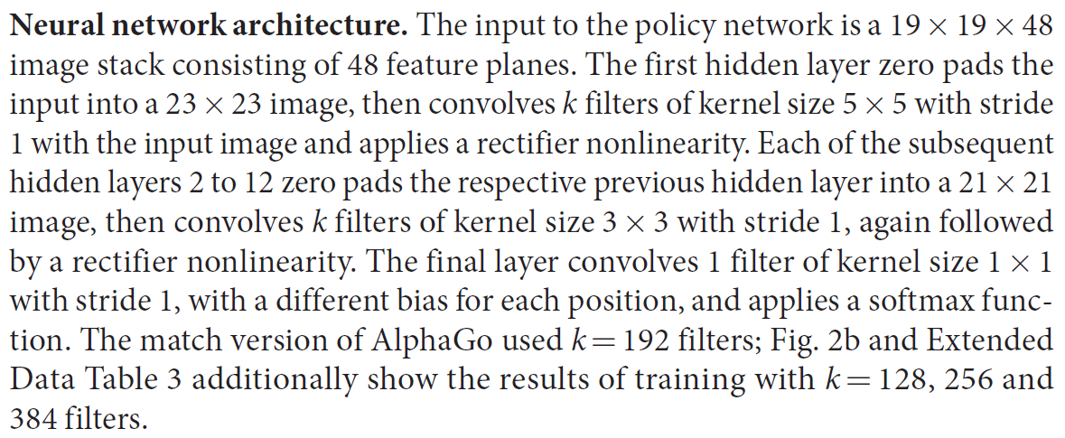
Why CNN for playing Go?
Subsampling the pixels will not change the object
Max Pooling
How to explain this???
Alpha Go does not use Max Pooling ……
Notes:
Very good example for desing your network

Slide 47

More Application: Speech
The filters move in the frequency direction.
CNN
Frequency
Image
Time
Spectrogram

Slide 48

More Application: Text
?
Source of image: http://citeseerx.ist.psu.edu/viewdoc/download?doi=10.1.1.703.6858&rep=rep1&type=pdf

Slide 49
Acknowledgment
感謝 Guobiao Mo 發現投影片上的打字錯誤

